Slide 1

Tripping the Wire to the Exit Conveyor
7.17.24 version 1.0

Slide 2
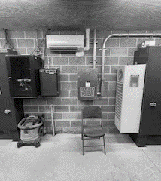
Assumptions and Prerequisite Skills
none
Supplies Needed
A small screwdriver (head doesn’t matter)

Slide 3
Preface
To tell when the wire to the exit conveyor has tripped, look for certain indications. The first indication on the wet side is when the pallet magazine only has two pallets left (insufficient for Besser to continue), and there are pallets in the exit conveyor, but they are not moving. Consult with the operator on dry side to see if there are any problems that would cause the exit conveyor to stop whether it be depalleter, cuber, patternmaker, etc. If that operator does not see any issues on dry side, this may mean that the wire tripped for the exit conveyor.

Slide 4
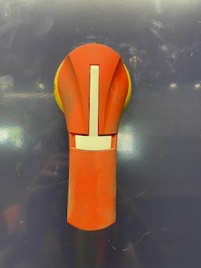
1. Proceed to the control room. Use your screwdriver and insert it into the hole on the side of the switch to open the right control panel (Figure 1) .
Figure 1

Slide 5
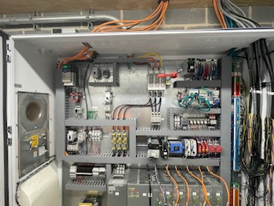
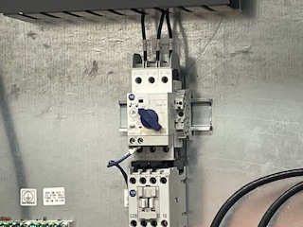
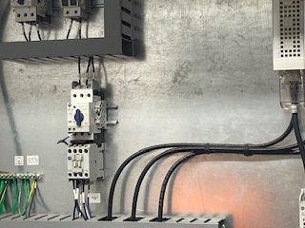
2. Turn the blue switch back up to the vertical position. Close the doors when you are finished .
Figure 2a
Figure 2b
Figure 2c

